Slide 1


From CTF to Real World
Reverse Engineering
Satria Ady Pradana

Slide 2
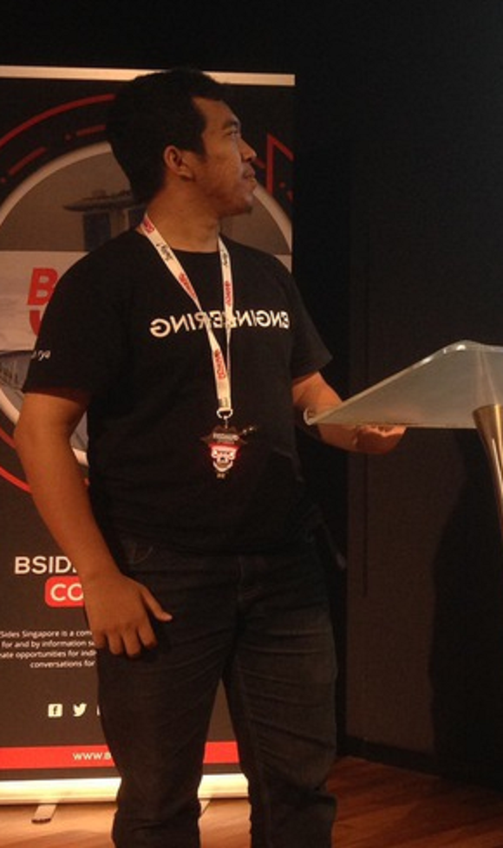



Who?
Satria Ady Pradana
Lead of Operation at Archonlabs
Penetration Tester, Red Team
Community Leader of Reversing.ID
@xathrya
xathrya
xathrya_

Slide 3
Reverse Engineering
Cracking …?
Learn how thing works
Art and science of understanding the mechanics of man-made creation, extracting the design, and recreate anything based on the knowledge.
It means …
Creative thinking
Continuous learning
Time consuming.

Slide 4

Motivation
Interfacing
Improve documentation and shortcomings.
Bug fixing.
Creation of unlicensed duplicates.
Repurposing.
Finding security bugs.

Slide 5
Compilation & decompilation
Short Introduction

Slide 6
Overview
Generating program from source codes is called compilation.
The result of compilation is a program consists of a set of instruction understandable by machine.
Disassembly is a process of transforming the stream of hex code to equivalent assembly representation.
Decompilation is a process of transforming the stream of hex code to programming language in closest possible interpretation.
Disassembly is easier than decompile and give more reliable output.

Slide 7
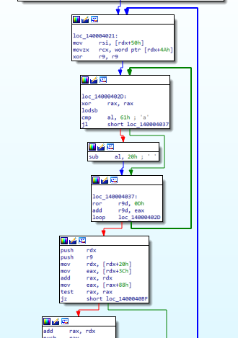
Graph
Overview for easier navigation of the piece of code.
Execution flow is modeled by direction.
Function consists of block, known as Basic Block.
Basic Block consists of instructions.
Branch is a directed connection between two blocks.
From source block to destination block.
At most only two branch out from source block.
A block may be destination of many branches.

Slide 8
CODE REVERSING (SIMPLIFIED)
Binary
Assembly
Code
Disassembly
Decompile

Slide 9
Native vs interpreted codes
Native Code
Interpreted Code
Run by processor directly.
Bound by processor specification.
No metadata translated from source code.
Run by interpreter (process VM).
Indirectly by processor.
Bound by VM specification.
Usually has metadata describing the code structure.
Ex: .NET, Java, Python
Determining how to handle it

Slide 10
STRINGS! Strings!! Strings!!!
And more strings

Slide 11
String
Sequence of characters.
C string: terminated by null.
Pascal string: preceded by length.
Heavily used in program to deliver information.
Export/import function name.
Error messages.
URL, endpoint, etc.
Might be stored in raw or encoded format.

Slide 12
Code Protection
Now you can’t analyze me!

Slide 13
Common Protection
Anti Debugging
Anti Disassemble
Anti Emulation
Code Obfuscation
Packing
https://github.com/ReversingID/Binary-Samples/tree/master/anti-analysis

Slide 14
Program Modification

Slide 15
Modification
Change the properties of binary (executable) for specific purpose.
Patching
Resource modification
Recompilation

Slide 16
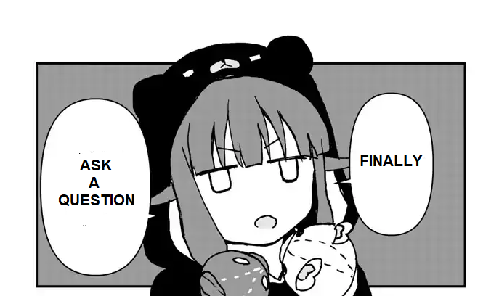

Slide 17
Thank You
Satria Ady Pradana
spradana [at] archonlabs.id
@xathrya (telegram)

